Slide 1






BANK LOAN ANALYSIS

Slide 2
Understanding the KPI’s
1. Year wise loan amount Stats
to understand how loan amounts have changed over the years.
2. Grade and sub grade wise revolving balance.
revolving balance for each grade and subgrade.
This can help identify if there's a correlation between a borrower's credit quality and their revolving balance.
3. Total Payment for Verified Status Vs Total Payment for Non Verified Status
We can compare the total payments made by borrowers with verified income/employment status versus those with non-verified status.
This can provide insights into the impact of income verification on repayment behavior.
4. State wise and last-credit-pull-d wise loan status
can reveal regional and temporal patterns in loan performance.
We can create a cross-tabulation or visualization to show the loan status distribution for each state and month/year of the last credit pull.
5. Home ownership Vs last payment date stats
number of days since the last payment for each category of home ownership (e.g. - own, rent, mortgage).

Slide 3
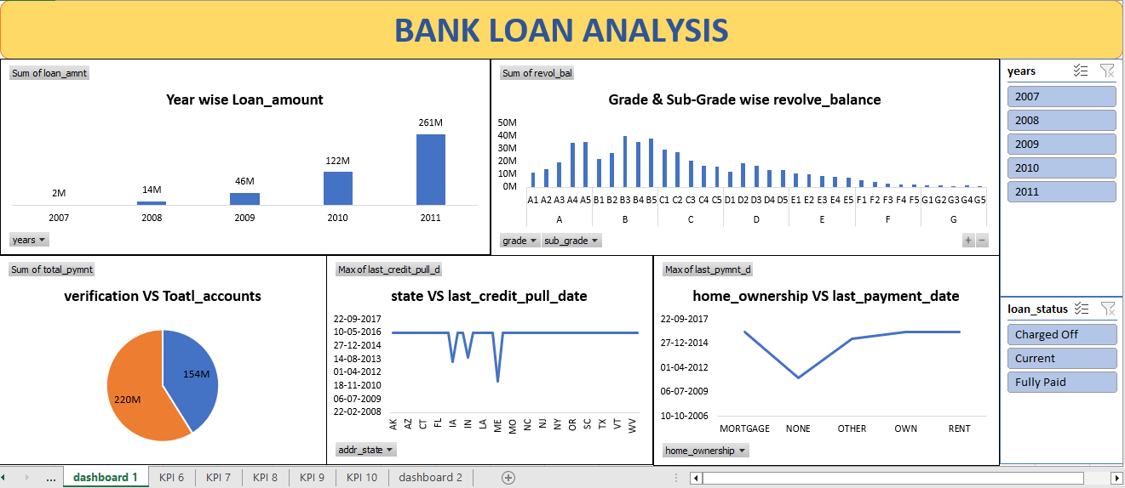
Excel Dashboard

Slide 4
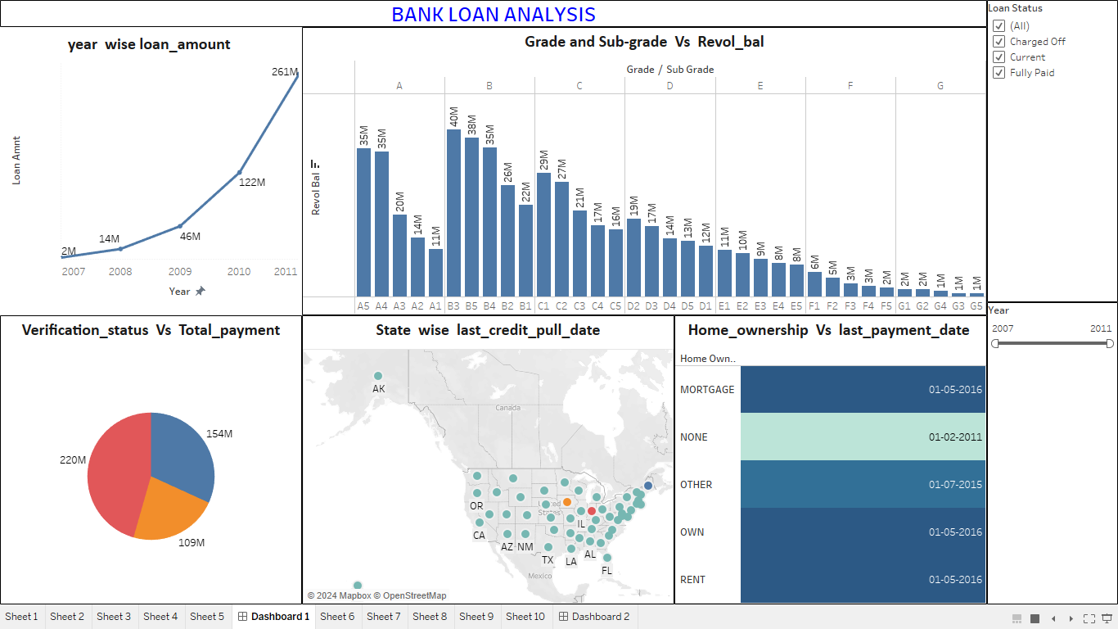
Tableau Dashboard

Slide 5
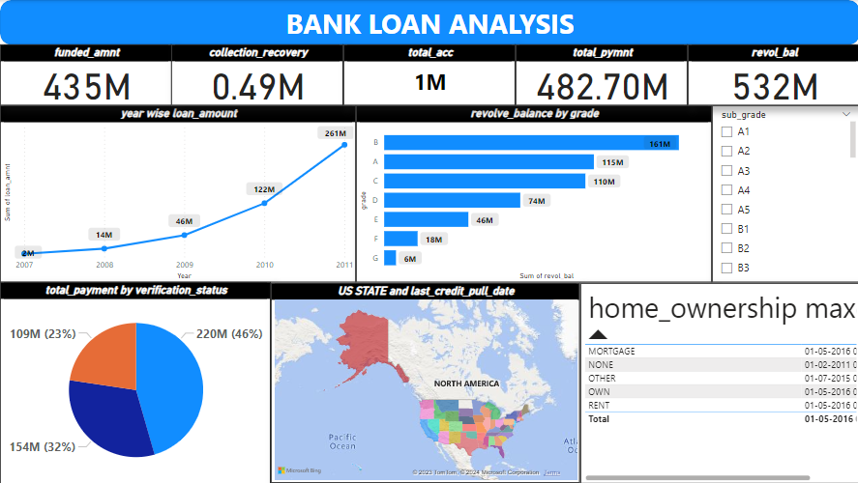
Power BI dashboard

Slide 6
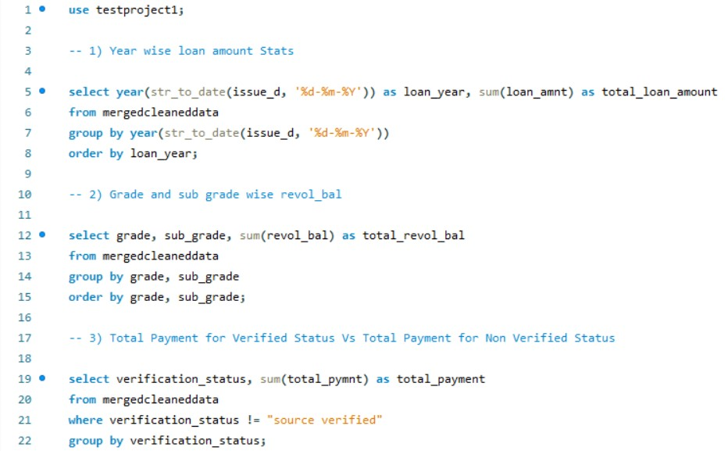
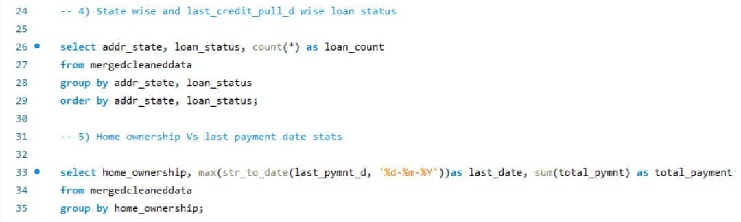
MySQL

Slide 7
Summary
a positive trend in year-wise loan amounts,
concern with 'B' grade revolving balances,
importance of verification for higher payments,
state-wise credit pull date variations,
overall timely payments across home ownership categories.

Slide 8
Thank You

